Slide 1
Fun With Lists!

Slide 2














Thanks to our
Sponsors

Slide 3
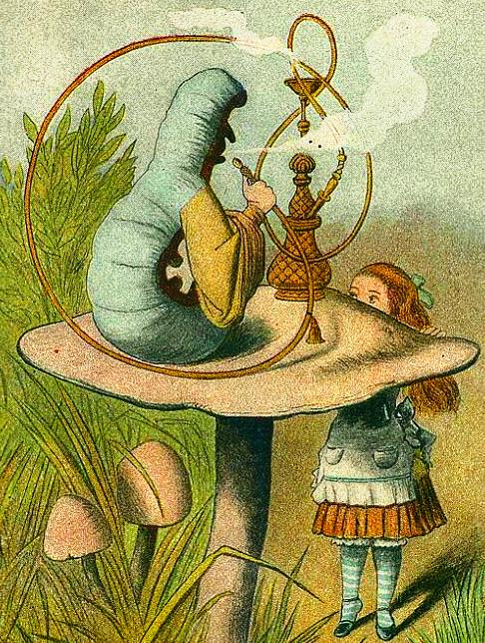





Slide 4




@SandyU

Slide 5






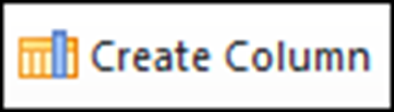

Slide 6
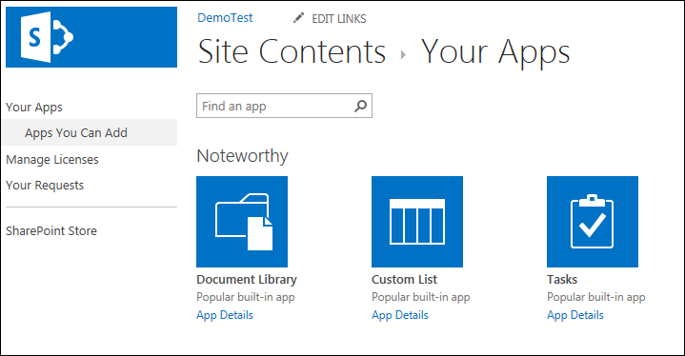

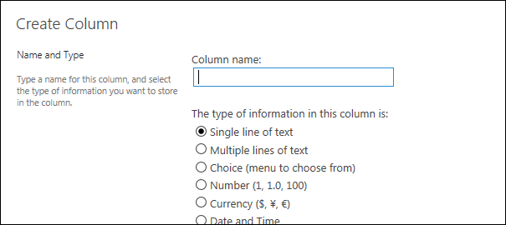
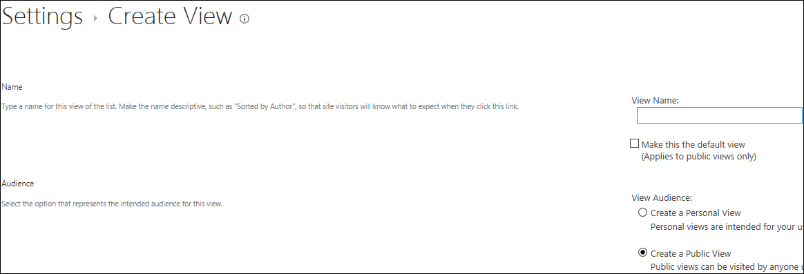

Slide 7
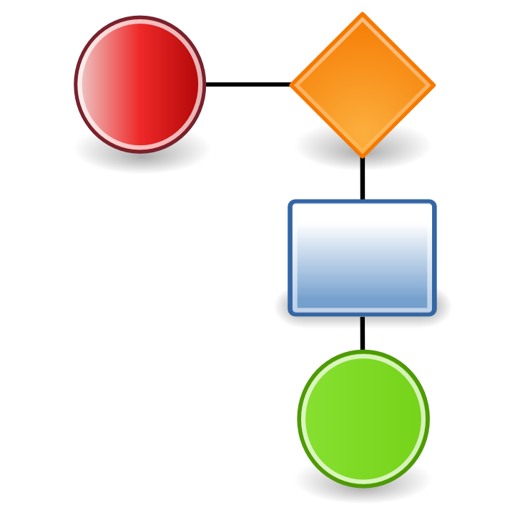


X

Slide 8
Column Types
Single line of text (default 255 characters)
Multiple lines of text (plain OR enhanced rich text)
Choice (drop-down, radio buttons, checkboxes – allow fill-in)
Number (min/max, decimal places, %)
Currency (2 decimal places by default, many currencies)
Date and Time (time always stored)
Lookup (if more options, or dynamic – list must be in same site)
Yes/No (check box)
Person or Group (choice of display fields)
Hyperlink or Picture
Calculated (calculation based on other columns)
Task Outcome (for workflow results)
External Data (uses Business Connectivity Services)
Managed Metadata (term store)

Slide 9
Validations & Defaults
Validate # of characters in text column: =len([item no])=6
List validation (to compare column values): e.g. [price]>[cost]
Default calculated value: e.g. [today]+30
No Default Value available: Multiple lines of text, Lookup, People/Group, Hyperlink/Picture, Calculated, External data
No Validation available: Multiple lines of text, Lookup, Yes/No, People/Group, Hyperlink/Picture, Calculated, Task outcome, External data, Managed Metadata

Slide 10
Calculated Column references
Intro to Column calculations: http://office.microsoft.com/en-us/sharepoint-foundation-help/introduction-to-data-calculations-HA010379914.aspx
Calculated Field formulas comprehensive reference: http://msdn.microsoft.com/en-us/library/bb862071.aspx (for SharePoint 2010, but still relevant)

Slide 11
Columns which can be indexed
Single line of text
Choice (single value only)
Number
Currency
Date/time
Lookup (single value only)
Person/group (single value only)
Yes/No
Managed Metadata
SharePoint Help is fairly helpful on this topic!

Slide 12
View Types when creating a view
Standard (tabular)
Calendar (must have date/time columns)
Access (requires MS Access)
Datasheet
Gantt (must have start/due dates)
Custom (using SharePoint Designer)

Slide 13
View Styles
(in Standard View Type)
Basic Table
Boxed (with or without labels)
Newsletter (with or without lines)
Shaded
Preview Pane
Default

