Slide 1


Reduce, Reuse, Recycle

Slide 2
Housekeeping…
Download EventBoard Mobile and remember to fill out session evaluations…
Phasers set to stun, mobile devices set to silent…
You must be present to win at the wrap-up…

Slide 3


















Thanks to our Sponsors!!!

Slide 4




@SandyU

Slide 5
Audience
100-level session
Power users, information workers
Why this topic?

Slide 6
Duplication
Examples
Same doc in multiple locations
Values in multiple locations (e.g. customer name)
Problems
Inconsistency
Updating issues
Solution:
Re-use wherever possible

Slide 7
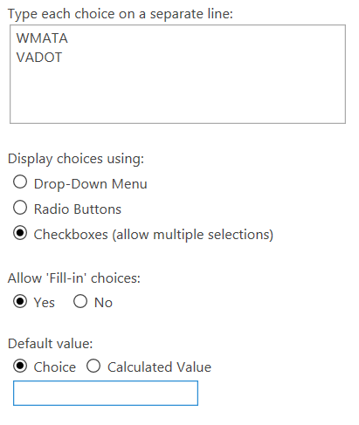
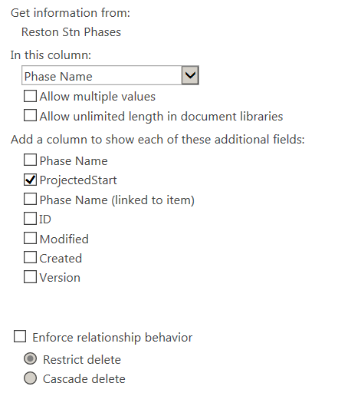


Choice or Lookup Column
Metadata – data about your data

Slide 8
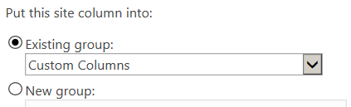
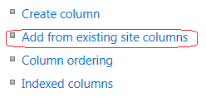
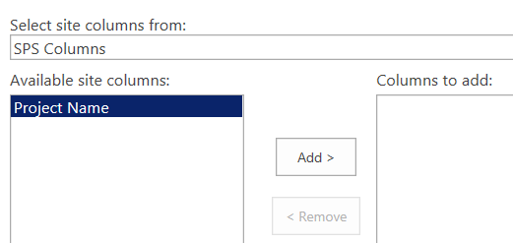
Site Column
Site Settings > Site Columns (under Web Designer Galleries)
Create column in Custom group or a new group
Add to list/library from List/Library Settings page

Slide 9
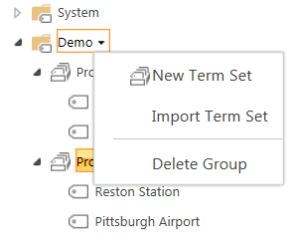
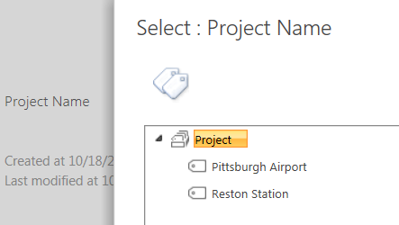
Managed Metadata
Site Settings > Term Store Management (under Site Administration)
Manage Term Store to add Term Sets and Terms
Select term when adding list/library item
* Server+/E/Midsize

Slide 10

External Data (via Business Connectivity Services)
Options
  External Data Column
  External List
  External data in Site Column (can’t add directly) – use Lookup to External List – column type will then appear as “External Data” and External Content Type will display in column properties
See Tom’s session at 10:45 today!
*E – limited sources

Slide 11
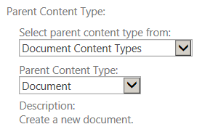
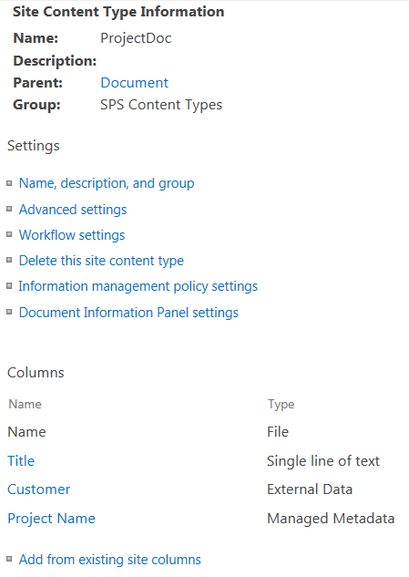
Content Type
Site Settings > Site Content Types (under Web Designer Galleries)
Select similar existing Parent Content Type as basis
Add to Custom or new CT Group
Add OOB or custom Site Columns to CT
See Scott’s session at 1:00 today!

Slide 12
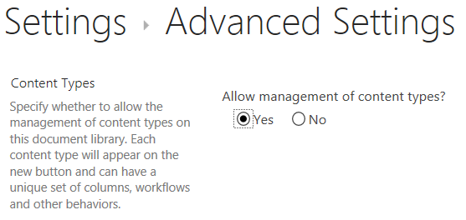
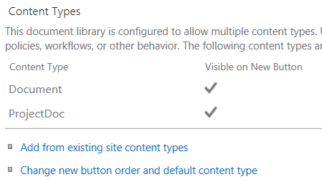
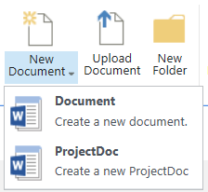
Content Type (usage)
Must allow Content Types in list/library (Advanced Settings)
Add CT in Library Settings so items can use it

Slide 13
Special Content Types
Link to a Document – include document/form in multiple libraries without copying it
Page Layout – available on Publishing sites (essentially a reusable page template)

Slide 14

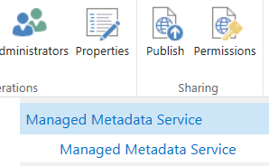

Content Type Hub
To use Content Types in other Site Collections
Activate Content Type Syndication Hub Feature on Site Collection whose Content Type Gallery will be used as the hub
In Central Admin > Service Applications, edit properties of Managed Metadata Service
Add URL of hub Site Collection
https://<tenant>.sharepoint.com/sites/contenttypehub

Slide 15
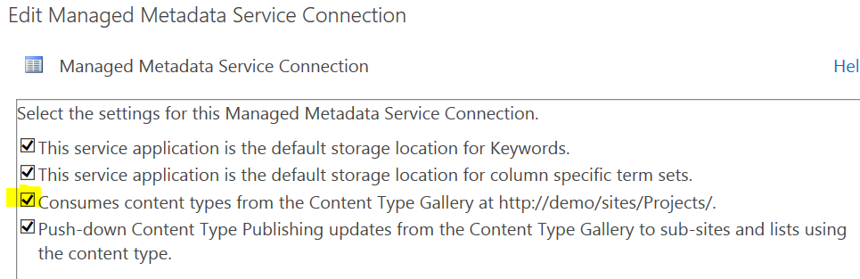
Content Type Hub (continued)
In properties of Managed Metadata Service Connection, select option to consume Content Types from hub
View settings of a Content Type in the hub gallery to see new option to Manage Publishing for this Content Type
https://<tenant>.sharepoint.com/sites/contenttypehub

Slide 16
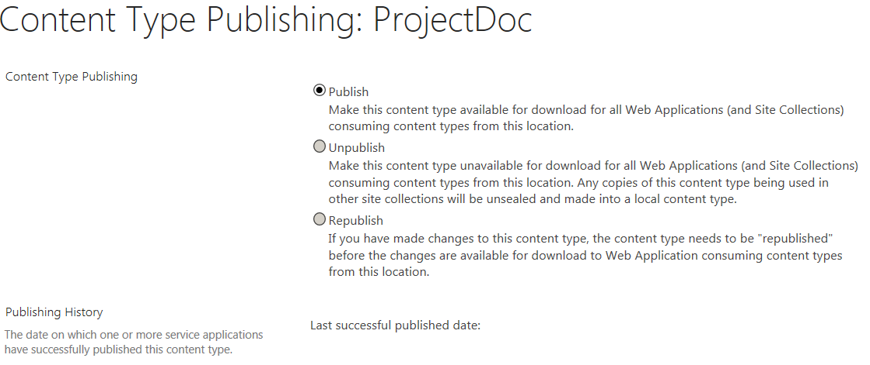
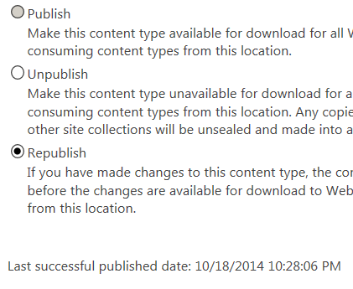
Content Type Hub (continued)
Click OK to publish the Content Type
After:
https://<tenant>.sharepoint.com/sites/contenttypehub

Slide 17


Content Type Hub (continued)
Content Types from the hub are now available in other Site Collections, even in other Web Apps
Custom Site Columns from the hub are also available in other Site Collections
https://<tenant>.sharepoint.com/sites/contenttypehub

Slide 18
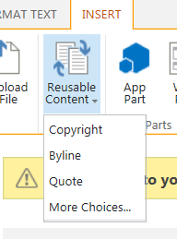
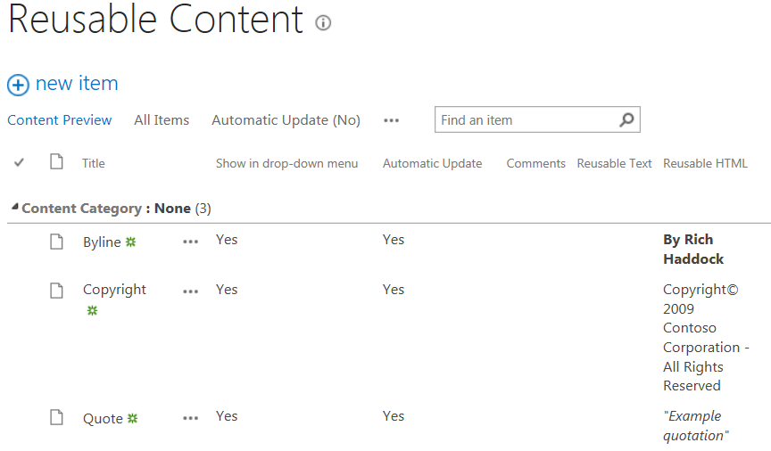
Reusable Content
Available only on Publishing sites, to add stock content to a page
List automatically created (with sample content) at root of Publishing Site Collection
Available from ribbon when editing
* Server+/E/Midsize

Slide 19
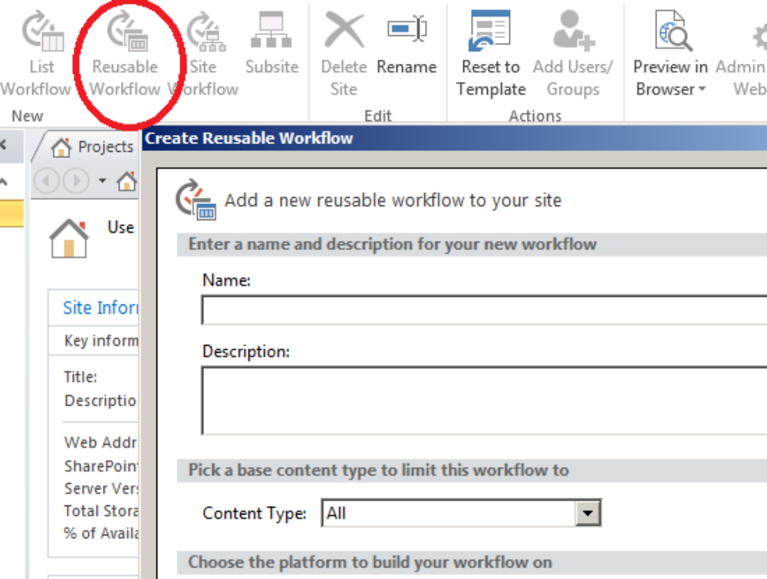
Reusable Workflow
Not bound to particular list/library

Slide 20
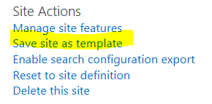
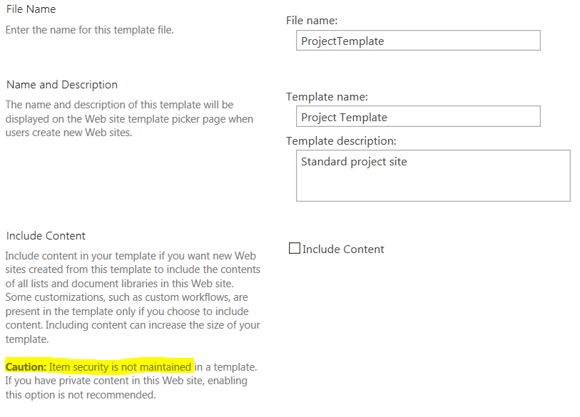
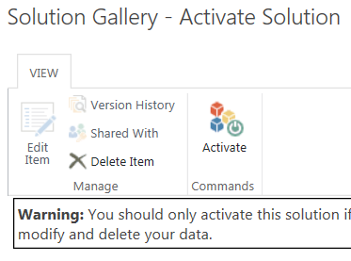
Site template
Choose whether or not to include content
Appears in Web Designer Galleries
> Solutions
Activate from dropdown
Now available when creating a site

Slide 21
Site template (cont’d)
Supported Lists, libraries, external lists, data source connections, list views and data views, custom forms, workflows, content types, custom actions, navigation, site pages, master pages, modules, and web templates.
Unsupported Customized permissions, running workflow instances, list item version history, workflow tasks associated with running workflows, people or group field values, taxonomy field values, publishing pages and publishing sites, My Sites, and stapled features.
For publishing sites, you can use site definition templates.
NOTE: Seems to be a problem with Site Column referencing external data

Slide 22
Questions?
Thank you!

Slide 23

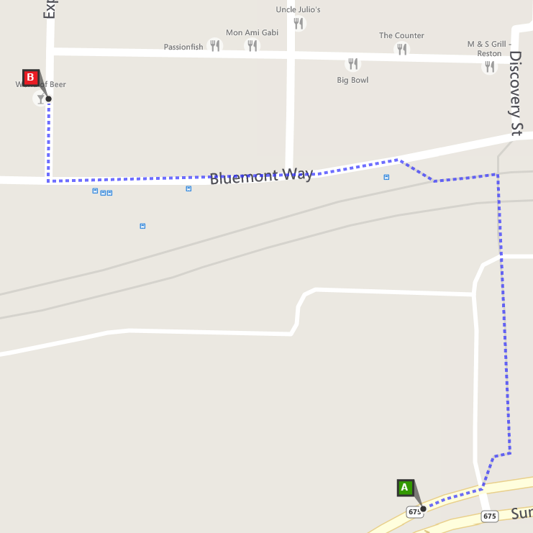
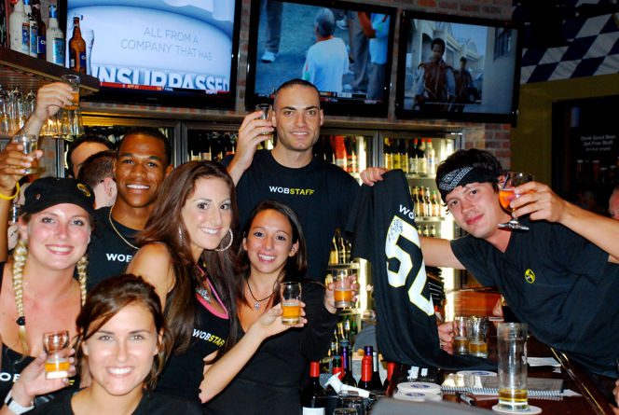
Join us at #SharePint sponsored by K2 at World of Beer of Reston in the Towncenter just across the bridge
Why? To network with fellow SharePoint professionals
What? SharePint!!!
When? 6:00 PM
Where?
World of Beer Reston
1888 Explorer Street
Reston, VA 20190
Thanks to?
K2!

